Slide 1
Open Source Software
Prof. Dr. Dirk Riehle
Friedrich-Alexander University Erlangen-Nürnberg
COSS C01
Licensed under CC BY 4.0 International
Notes:
It is Friedrich-Alexander University Erlangen-Nürnberg – FAU, in short.
Corporate identity wants us to say “Friedrich-Alexander University”.

Slide 2
Agenda
Legal definition (open source software)
A (very) short history
Traditional open source
Challenges to traditional open source
Open source foundations
Open source control mechanisms
Community vs. commercial open source

Slide 3
1. What is Open Source Software?

Slide 4


Free and Open Source Software Definition
Software is free software [1] if
  The user is granted rights to
    Use, study, modify, and distribute the software
    Free of charge and other restrictions
Managed by the Free Software Foundation
For all practical purposes, free and open source software are the same
Software is open source software [2] if
  The user granted rights to
    Use, modify, and distribute the software
    Free of charge and other restrictions
Managed by the Open Source Initiative
[1] See https://www.gnu.org/philosophy/free-sw.html.en
[2] See https://opensource.org/osd

Slide 5

Example Open Source Software

Slide 6
Anatomy of Open Source Licenses
Copyright notice
  The name of the owner and when this work was created and updated
Rights grant
  The rights granted to a user if they fulfill obligations matching the use-case
Obligations to fulfill
  A set of obligations (requirements) before the rights grant becomes valid
Prohibitions (none in the MIT license)
  A set of things the user is prohibited from
Disclaimer
  The usual disclaimer of warranties, guarantees, etc.

Slide 7
The MIT License (Template)
Copyright <YEAR> <COPYRIGHT HOLDER>
1
Permission is hereby granted, free of charge, to any person obtaining a copy of this software and associated documentation files (the "Software"), to deal in the Software without restriction, including without limitation the rights to use, copy, modify, merge, publish, distribute, sublicense, and/or sell copies of the Software, and to permit persons to whom the Software is furnished to do so, subject to the following conditions:
2
The above copyright notice and this permission notice shall be included in all copies or substantial portions of the Software.
3
THE SOFTWARE IS PROVIDED "AS IS", WITHOUT WARRANTY OF ANY KIND, EXPRESS OR IMPLIED, INCLUDING BUT NOT LIMITED TO THE WARRANTIES OF MERCHANTABILITY, FITNESS FOR A PARTICULAR PURPOSE AND NONINFRINGEMENT. IN NO EVENT SHALL THE AUTHORS OR COPYRIGHT HOLDERS BE LIABLE FOR ANY CLAIM, DAMAGES OR OTHER LIABILITY, WHETHER IN AN ACTION OF CONTRACT, TORT OR OTHERWISE, ARISING FROM, OUT OF OR IN CONNECTION WITH THE SOFTWARE OR THE USE OR OTHER DEALINGS IN THE SOFTWARE.
5

Slide 8
The Most Common Obligations
Legal notices
  Provide attribution
  Provide license text
  Provide disclaimers
  Provide additional notices
Copyleft

Slide 9
Open Source License Categories and Families
No License
Permissive
Weak Copyleft
Copyleft
Public
Domain
MIT / X11
LGPLv2.1
GPLv2
New BSD
LGPLv2.1+
GPLv2+
Apache 2.0
LGPLv3 (+)
GPLv3 (+)
Mozilla 1.1
Affero
GPLv3 (+)

Slide 10
Distribution and Rights Propagation
C
V
U
Licensor
Licensor
Licensee
Licensee
original distribution
redistribution

Slide 11
The Open Source Software Supply Chain
product
closed source
comp #24
open source
proj #5332
open source
proj #152
open source
comp #897
open source
proj #832
open source
proj #21632

Slide 12
A (very) short history
2. A (Very) Short History

Slide 13
Short History of Open Source
1960-1979: Not-born-yet (the first era) [LT02]
  Little or no recognition of software as intellectual property
  Free sharing of source code, allowing for rapid diffusion and innovation
1980-1989: Philosophy (the second era)
  Founding of the Free Software Foundation by Richard Stallman in 1985
  Invention of GNU public license for “freeing software”
1990-1999: Pragmatism (the third era)
  Founding of Open Source Initiative in 1998, increased pragmatism
  Start of growth in number of projects as well as open source licenses
2000-2009: Professionalization (the fourth era)
  Professionalization of open source, away from pure volunteerism
  Increased focus on commercialization
2010-today: Mainstream (the current era)
  Continued strong growth, simplified access, improved tooling
  Open source as an on-ramp to the cloud

Slide 14
Sustainable Open Source Projects
Non-profit open source organizations
  Confederated community projects
  Open source vendor-led foundations
  Open source user-led foundations
For-profit open source firms
  Single-vendor open source firms
  Open source distributor firms
  Service and support firms

Slide 15
Open Source Project Strata and History
User-led consortia (foundations)
2009
GenIVI Alliance
2005
Kuali Foundation
Single-vendor open source firms
1995
MySQL
2004
SugarCRM, Jaspersoft, Hyperic, ...
Developer-led foundations
(Natural persons and vendors)
2004 Eclipse Foundation
1999
Apache Software Foundation
2007
Linux Foundation
Open source distributor firms
1994
Red Hat
2004
Canonical
1992
Suse
2002
Univention
Service and support firms
2011
Hortonworks
1989
Cygnus Solutions
2005
Automattic
2009
MariaDB
Traditional community projects
1987
GCC
1993
Debian
1984
GNU Emacs
1991
Linux kernel
1996
PostgreSQL
2004
CentOS
year
Not a complete history: Events have been chosen for illustration purposes

Slide 16
A (very) short history
3. Traditional Open Source Software

Slide 17
Aspects of an Open Source Project [1]
Name
License
Place
Rights
[1] Bad naming: Neither open source software nror their communities
are projects

Slide 18



The Name of an Open Source Project
Uniquely identifies project
Ideally supported by place / domain
Should be trademarked
Often visually supported

Slide 19
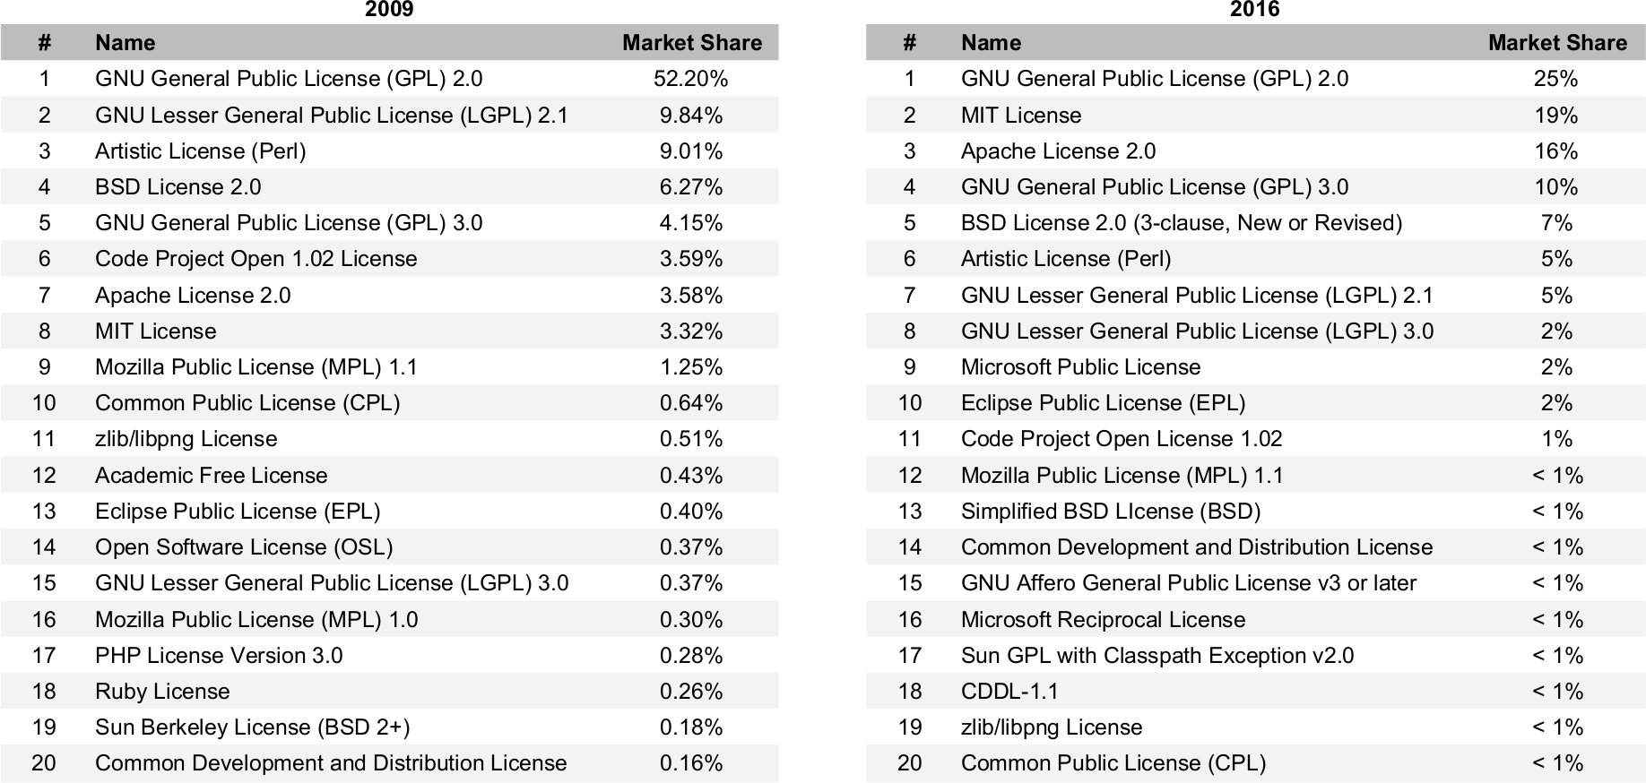
The License of an Open Source Project

Slide 20
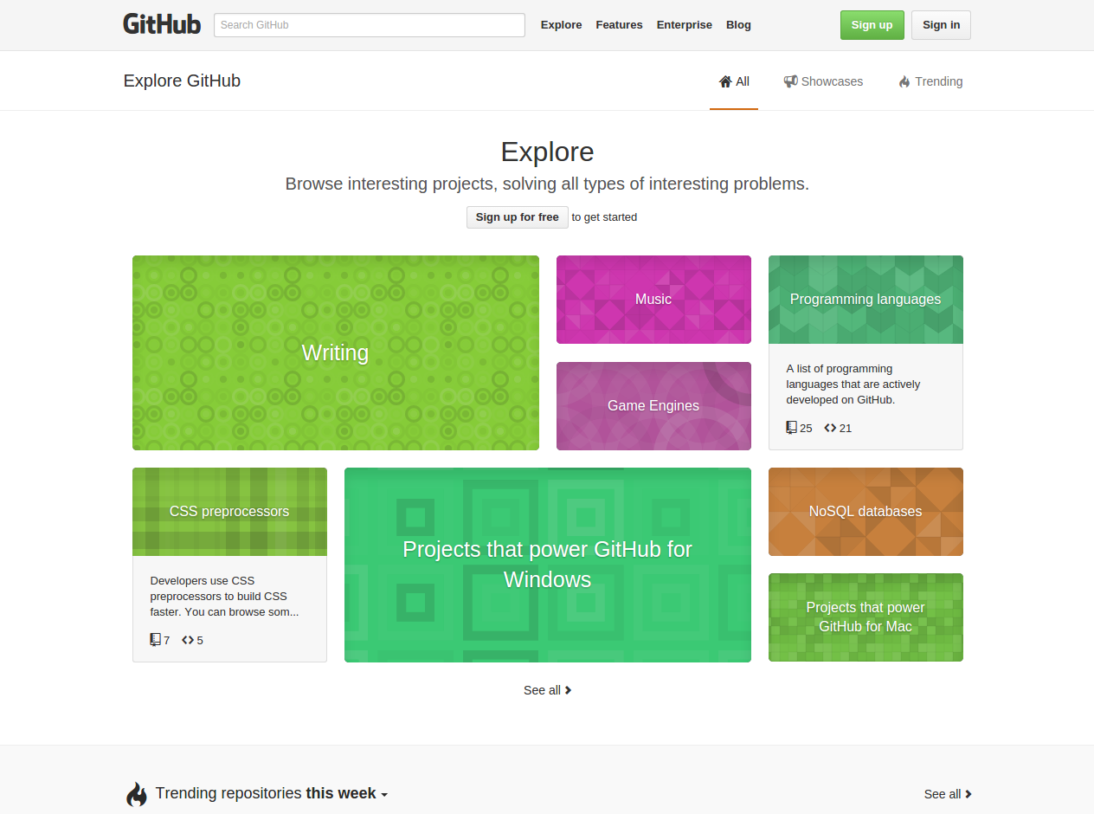
The Place of an Open Source Project
Wants to be found
Wants to explain itself
Needs to market itself
Where work gets done

Slide 21
The Rights to an Open Source Project
Copyright
Trademark rights
Domain ownership
Sysadmin access
Commit rights

Slide 22
A (very) short history
4. Challenges to Traditional Open Source

Slide 23
Challenges to Traditional Open Source
Challenges to using open source code
  Ensuring license compliance
  Ensuring clean intellectual property
  Managing security vulnerabilities
  Managing the technical dependency
Challenges to contributing to project
  Avoiding abuse of contributions
  Maintaining your interests
Challenges to building a business
  Ensuring access to trademarks
}
Maintaining your interests

Slide 24
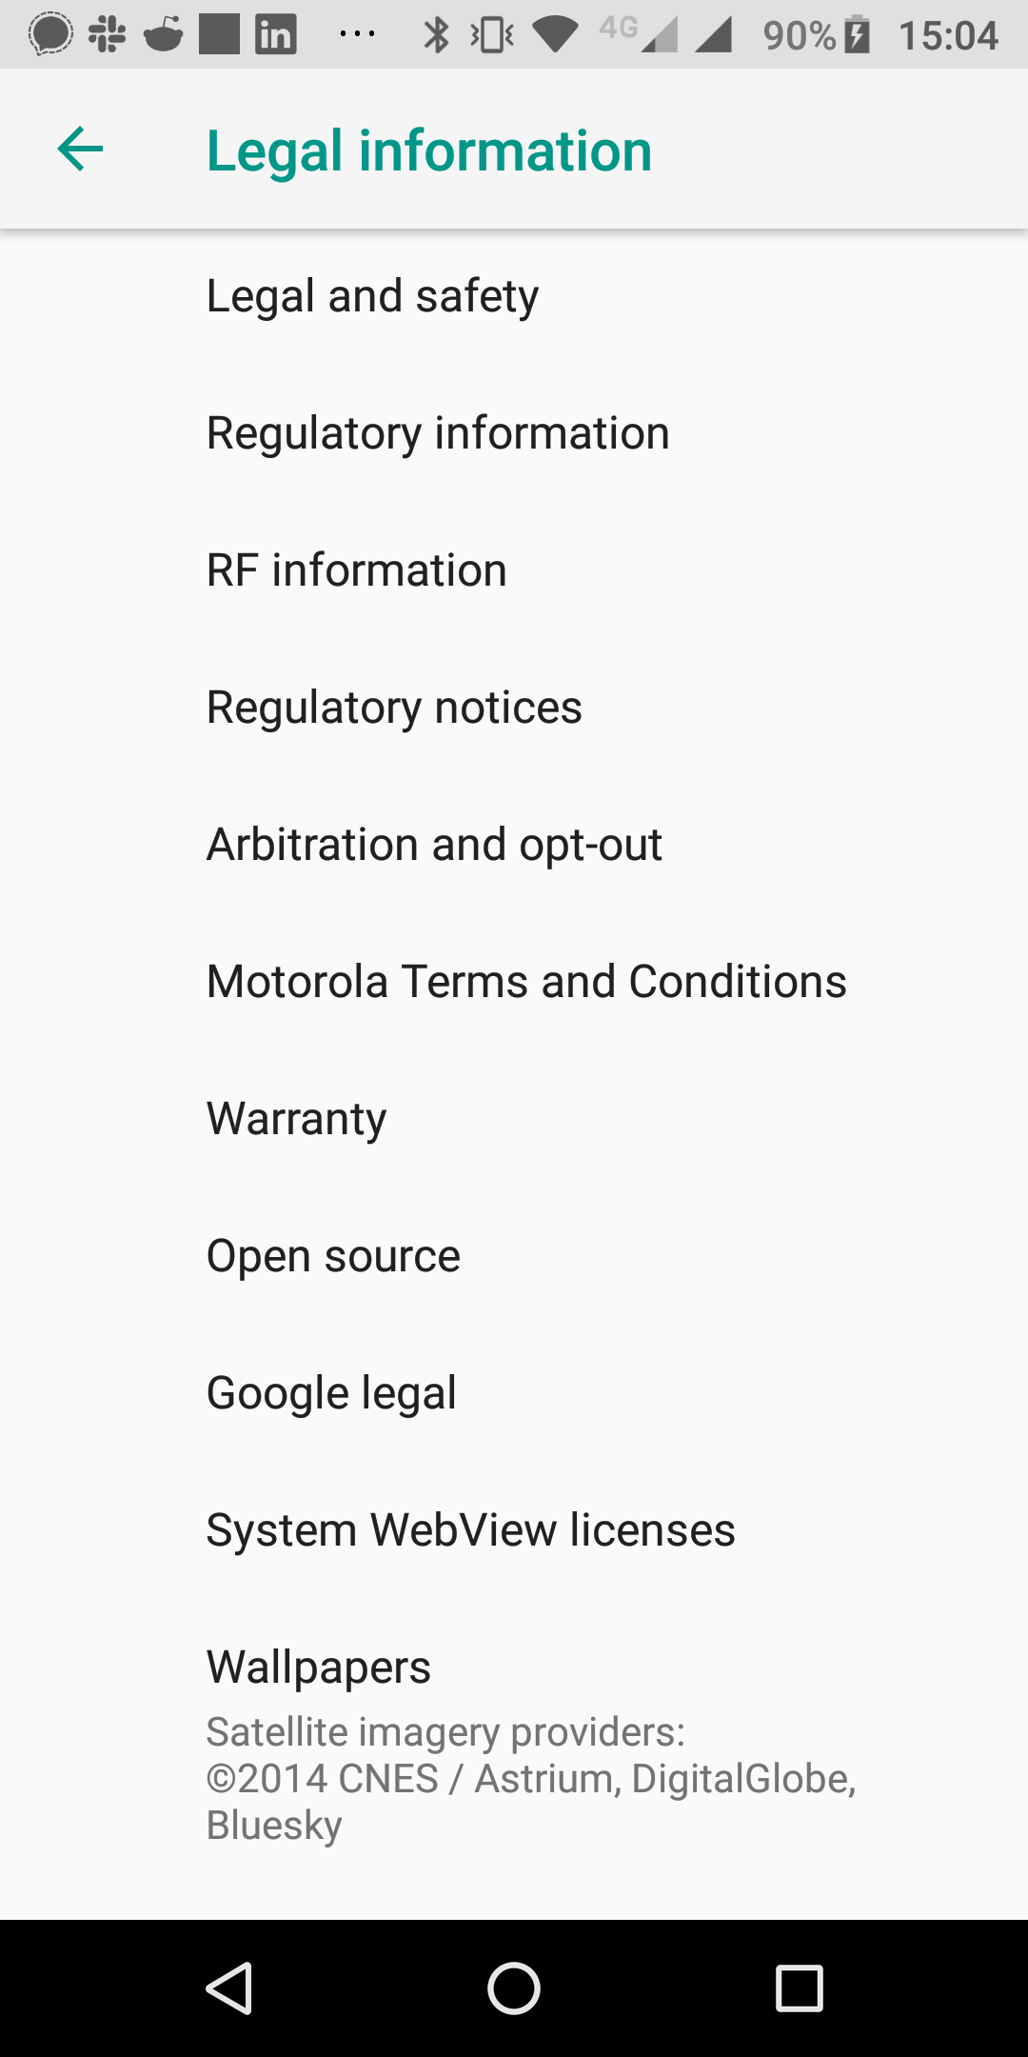
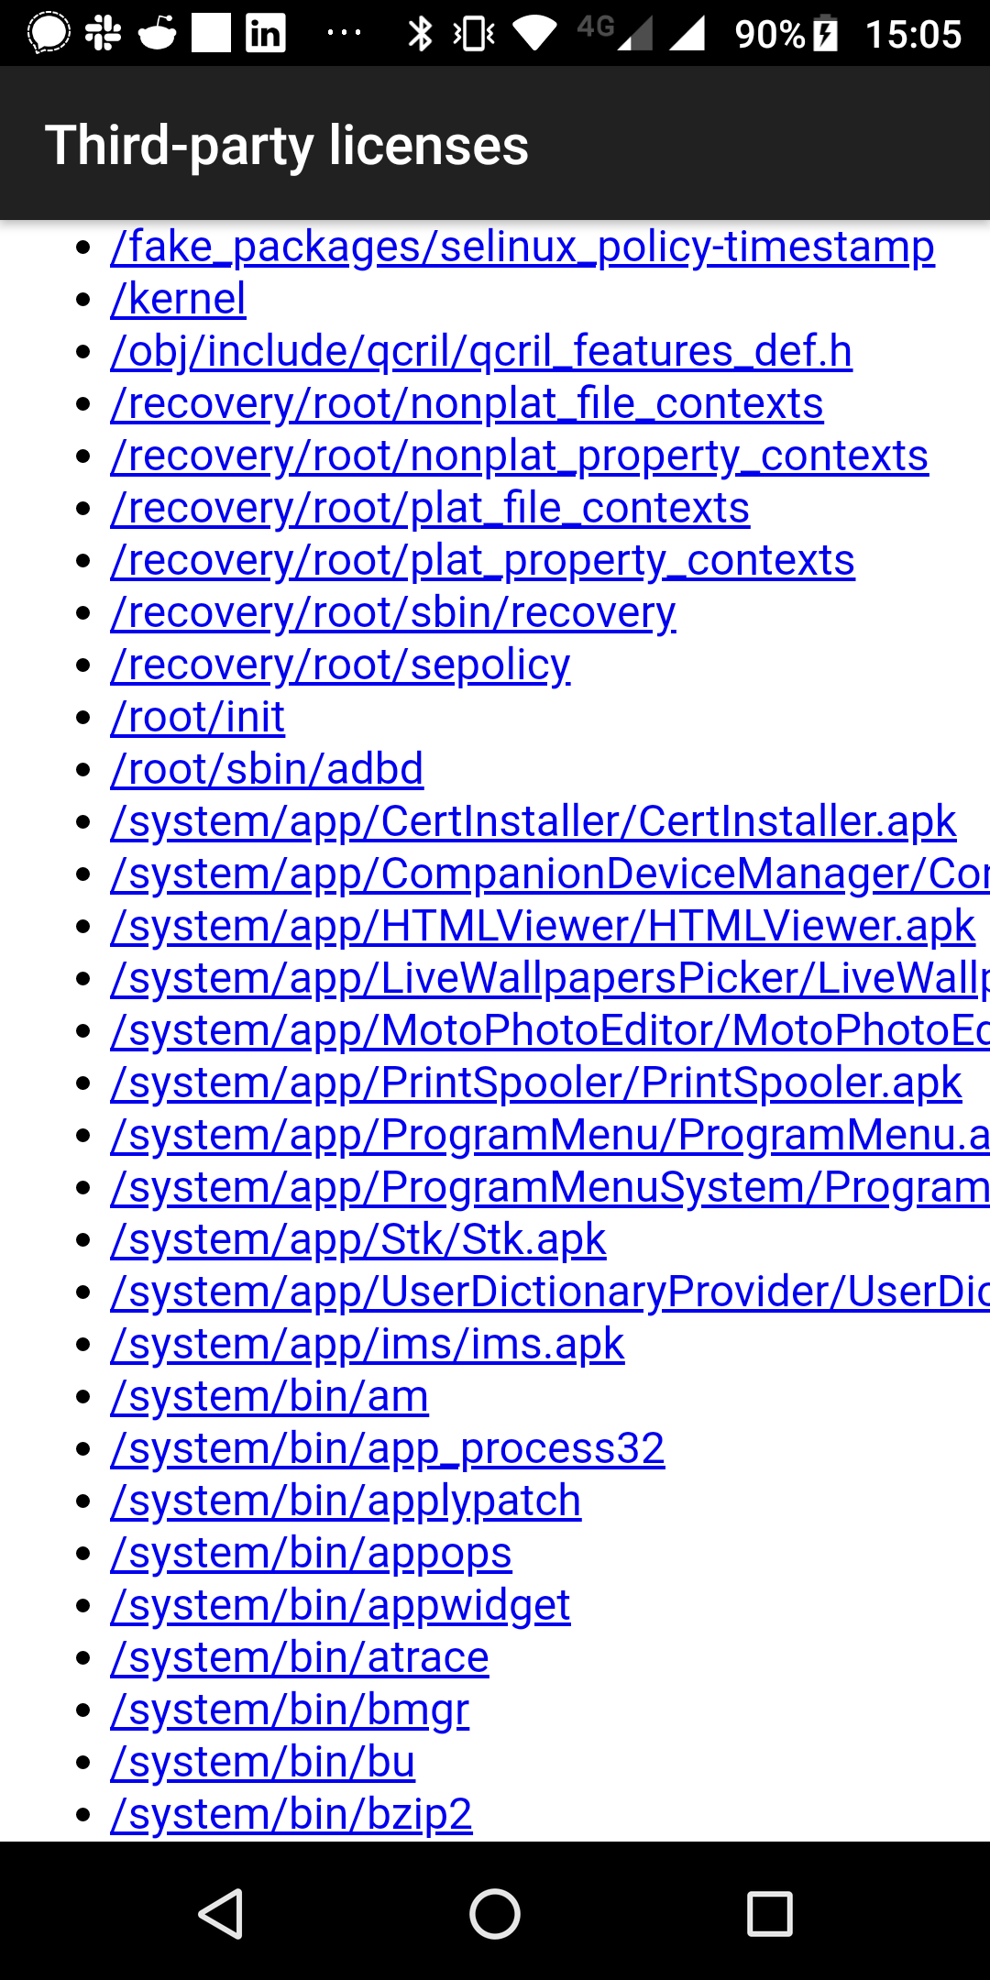
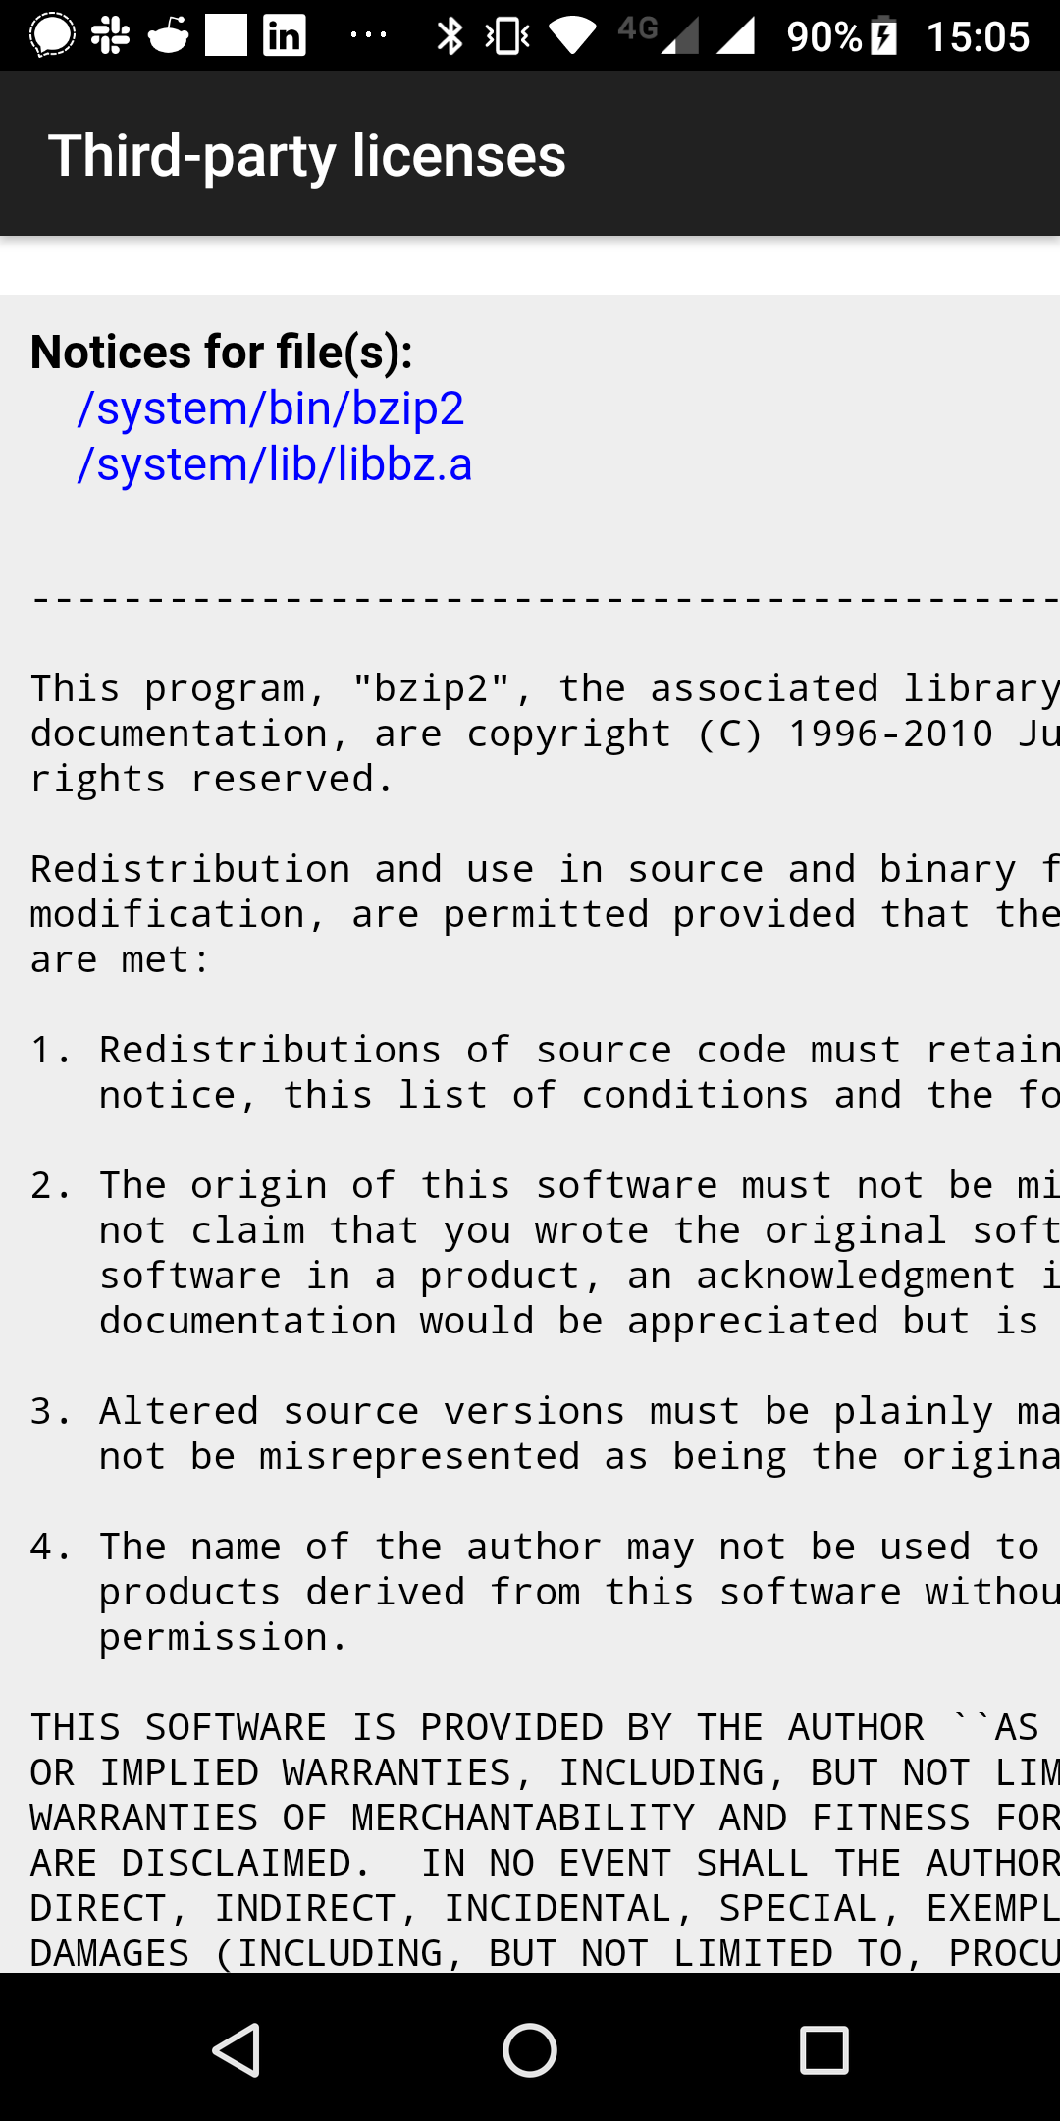
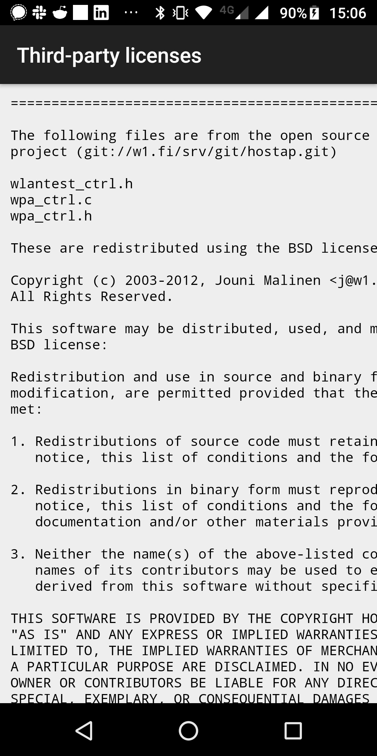
Ensuring License Compliance

Slide 25

Ensuring Clean Intellectual Property [1]
[1] See https://www.eclipse.org/projects/dev_process/ip-process-in-cartoons.php

Slide 26
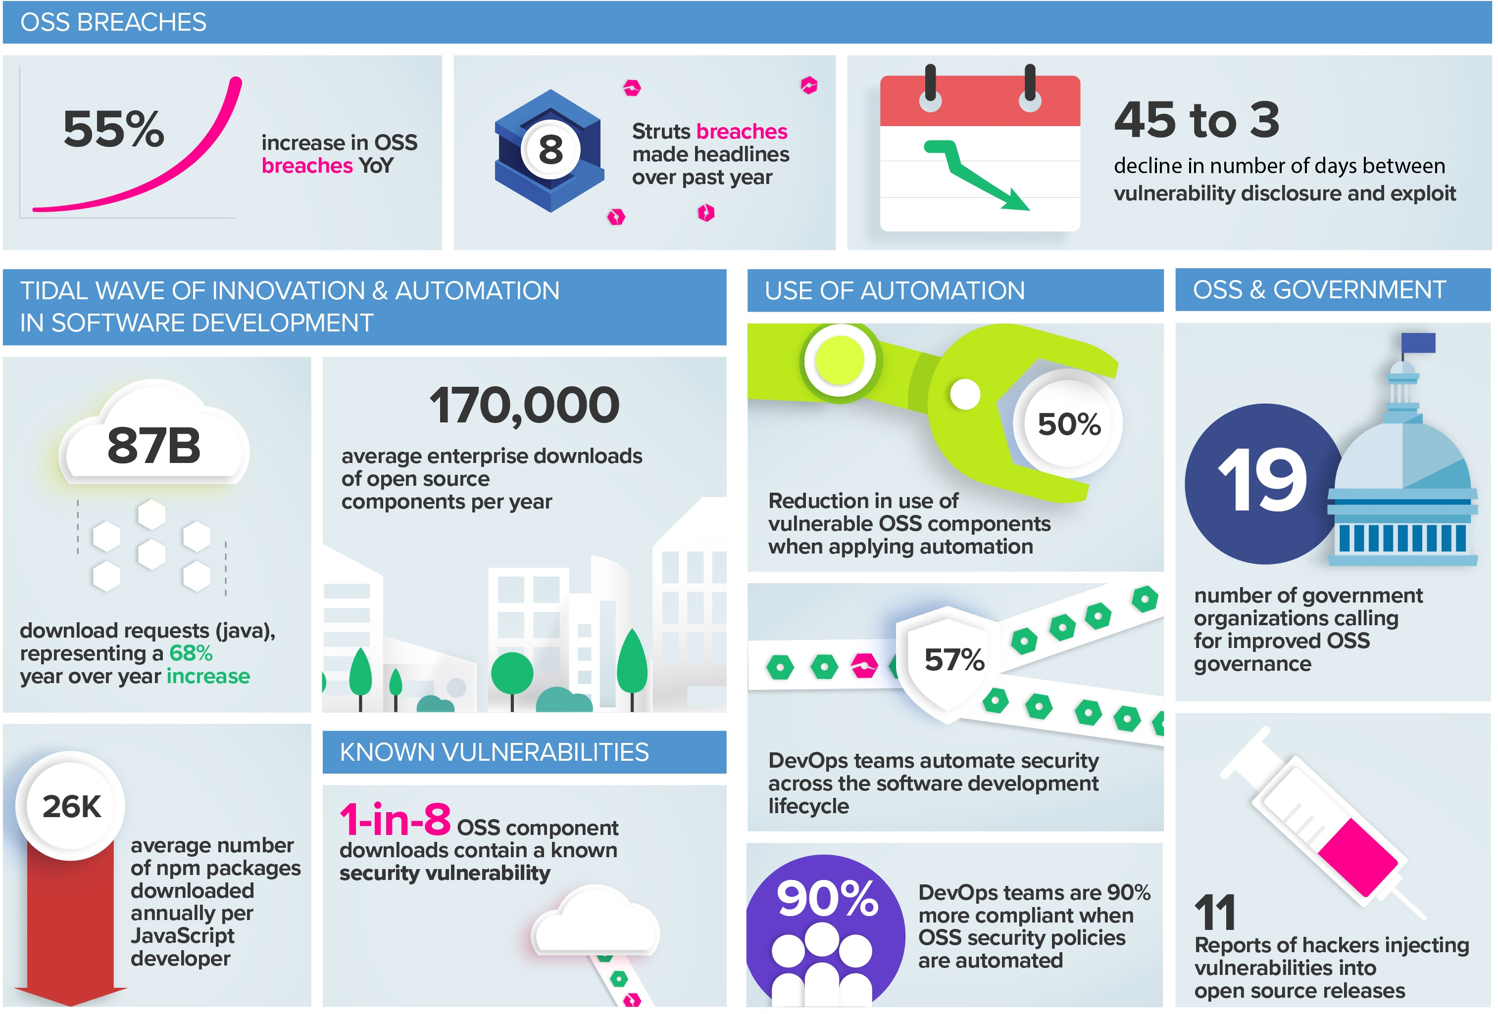
Managing Security Vulnerabilities [1]
[1] See https://blog.sonatype.com/2018-state-of-the-software-supply-chain-report

Slide 27
Managing the Technical Dependency (Maintaining Your Interests)
Software vendor
product
Supplier tier 1
...
...
closed source
comp #24
open source
proj #5332
open source
proj #152
...
Supplier tier n
...
open source
comp #897
open source
proj #832
open source
proj #21632

Slide 28






Ensuring Access to Trademarks (Maintaining Your Interests)

Slide 29
A (very) short history
5. Open Source Foundations

Slide 30
Developer-led Open Source Foundations [R10a]
An developer-led open source foundation is
  a non-profit organization (foundation, consortium)
  with the purpose of managing and performing the development of
  non-differentiating open source software
  made available to foundation members and the general public
Typical members of a developer-led foundation are
  Individual developers
  Software vendors
  Service providers
  Consulting firms

Slide 31
























Example Developer-led Open Source Foundations

Slide 32
Motivation for Developer-led Foundations
Support and protect people and their projects
  Protect developers from lawsuits
  Accept donations; manage books
  Legally represent project interests
Create a stronger more competitive ecosystem
  Increase share of customer wallet
  Reach more price-sensitive customers
  Grow addressable market
Create a fair and equal playing field for members
  Regulate access to intellectual property
  Regulate access to marketing channels
  Regulate product roadmap and development

Slide 33
The Apache Software Foundation [A10]
The Apache Software Foundation […] provides an established framework for intellectual property and financial contributions that simultaneously limits contributors potential legal exposure. Through a collaborative and meritocratic development process, Apache projects deliver […] software products […]

Slide 34
Increase Share of Customer Wallet
Price of
product
$$$$
Potential
added revenues
$$
Price of
product
$$$$
Money spent on solution
Price of
closed source
component
$$$$
Cost of open
source component
$$
Without open source
With open source

Slide 35




“Ganging Up On The 800lb Gorilla”

Slide 36
Wordpress Foundation [M10b]
The point of the foundation is to ensure free access, in perpetuity, to the software projects […] As part of this mission, the Foundation will be responsible for protecting the WordPress, WordCamp, and related trademarks. A 501(c)3 non-profit organization […]

Slide 37
Types of Open Source Foundations
Open source
foundation
Developer-led
foundation
Community-led
foundation
Vendor-led
foundation
User-led
foundation
e.g. Apache Software Foundation
e.g. Linux Foundation
e.g. Kuali Foundation

Slide 38
A (very) short history
6. Open Source Control Mechanisms

Slide 39
Control Points and Steering Mechanisms [R11]
Intellectual property control
  Copyright control
  Patent ownership
  Trademark control
  Domain ownership
Position of power control
  Social leadership
  Committer rights

Slide 40
Copyright Control and How it Can be Used
Set-up
  You are the only party with full copyright or relicensing right
    Use a contributor (license) agreement to receive these rights from contributors
Power
  You can change the license going forward
    Including to no open source license at all

Slide 41
Patent Ownership and How it Can be Used
Set-up
  You register critical patents used in the software
    You chose a license without a patent usage rights grant
Power
  You can selectively keep people and companies from using the software
    Or charge for the patent usage right

Slide 42
Trademark Control and How it Can be Used
Set-up
  You own one or all relevant trademarks
    In open source, these are mostly textual and visual marks (logos)
Power
  You can pull trademark usage right permissions
    You force the project to fork and start a new identity

Slide 43
Domain Ownership and How it Can be Used
Set-up
  You own the domain and/or identifying properties
    Related properties are social media accounts etc.
Power
  Your can pull access to domains and accounts
    You force the project to fork and start a new identity

Slide 44
Social Leadership and How it Can be Used
Set-up
  You are one or the recognized leader of a project
    You do not have to be a developer, you just need the social recognition
Power
  You can split the project community, diminishing its power
  You can keep unwanted people out of the project

Slide 45
Committer Rights and How it Can be Used
Set-up
  You are a committer (core developer) of the project
Power
  You can vote to keep unwanted people out of the project
  You can delay or reject unwanted contributions
  You lead the technical direction of the project

Slide 46
Control Points and Steering Mechanisms are Negotiation Tools
You cannot retroactively revoke the open source license
Your opponents can always (threaten) fork the project

Slide 47
A (very) short history
7. Community vs. Commercial Open Source

Slide 48
Definition of Commercial Open Source
Commercial open source software is open source software that
  Is being managed and developed by one or more software vendors
    For the purposes of generating revenues through derived products
A commercial open source software vendor is a software vendor that
  Manages and develops commercial open source software
The product itself, sold by a vendor, is never open source software

Slide 49
Community vs. Commercial Open Source
 | Community Open Source |  | Commercial Open Source
 | Traditional | Foundation
Copyright control | Distributed | Foundation | Company
Patent ownership | Individual | Agreement | Company
Trademark control | Individual, if any | Foundation | Company
Domain ownership | Individual | Foundation | Company
Social leadership | Distributed | Distributed | Company
Committer rights | Earned | Earned | Assigned

Slide 50
Summary
Legal definition (open source software)
A (very) short history
Traditional open source
Challenges to traditional open source
Open source foundations
Open source control mechanisms
Community vs. commercial open source

Slide 51
Thank you! Questions?
dirk.riehle@fau.de – http://osr.cs.fau.de
dirk@riehle.org – http://dirkriehle.com – @dirkriehle
DR

Slide 52
Credits and License
Original version
  © 2020 Dirk Riehle, some rights reserved
  Licensed under Creative Commons Attribution 4.0 International License
Contributions
  None yet

